Slide 1
AGENTIC EDGE ENERGY INTELLIGENCE
EcoPulse AI
An edge-enabled agentic intelligence engine powered by IBM Granite models for automated campus energy monitoring, IoT relay control, and sustainability credit generation.
PRESENTED BY DEPARTMENT COLLEGE NAME
PRASHANT RAI B.Sc(Information Technology) BABASAHB BHIM RAO AMBEDKAR UNIVERSITY LUCKNOW ,UTTAR PRADESH

Slide 2
Problem Statement & SDGs:
Unattended Campus Waste: University classrooms and laboratories frequently leave lighting, fans, and AC units running during empty hours, causing huge energy waste.
Lack of Visibility: Department HODs lack real-time visibility into daily power consumption and actionable sustainability incentives to encourage departmental conservation.
EcoPulse AI directly contributes to the United Nations Sustainable Development Goals through automated agentic control and credit rewards:
SDG 7: Clean Energy
SDG 11: Sustainable Cities
SDG 13: Climate Action

Slide 3
AI Solution Overview:
Vision Frame
Multimodal vision analysis processing CCTV frames and digital meter displays to extract occupancy status and kWh metrics on the edge.
2. IoT State Event
Agentic control workflow monitoring occupancy trends to issue real-time MQTT commands (POWER_ON / POWER_OFF) to room relays.
3. EOD Report & RAG
RAG-driven baseline energy comparison, automated sustainability credit allocation, and executive markdown reports for HODs.

Slide 4

System Architecture & Flow:
Edge-Enabled Data Pipeline:
Edge Ingestion: IP cameras & smart meters stream visual frames to local IBM Granite 7B/13B models.
Agentic Decisions: Instant evaluation of occupancy duration triggers automated MQTT relay rules.
RAG Storage: SQLite/PostgreSQL ledger tracks room baselines vs actual monitored kWh daily logs.
Executive Deliverables: Jinja2 templates generate executive emails with Green Marketplace redemption options.

Slide 5
Agent Logic & Control Rules:
Vision Processing & Confidence Thresholding: High confidence detection (≥ 0.70) classifies room status. Handles both human occupancy detection and OCR extraction from digital smart meters.
Rule 1 (Unoccupied Power Cut): If occupancy_detected == false for ≥ 60 seconds and current power state is ON → Agent issues immediate POWER_OFF MQTT relay command.
Rule 2 (Occupancy Restoration): If occupancy_detected == true and current power state is OFF → Agent issues immediate POWER_ON command to restore lights and AC.
MQTT Protocol Standards: Published to campus/room/{room_id}/relay topic using QoS 1 (at-least-once) to guarantee delivery across campus networks.

Slide 6
RAG Engine & Credit System:
RAG Baseline Math & Ledger:
The RAG agent compares database baselines against actual daily smart meter logs to calculate financial and carbon impact:
Energy Saved (kwh)= Baseline – Actual Usage
CO2 Reduced(kg) = Energy Saved x 0.85
10
Credits Earned / kWh Saved

Slide 7
Responsible AI & Security:
Privacy & Edge Ethics
On-Device Local Inference: IBM Granite models execute locally on campus edge hardware. No raw video streams leave the building or get stored on external cloud servers.
Metadata Processing: Video frames are processed strictly in RAM and discarded immediately after occupancy inference to safeguard student and faculty privacy.
Governance & Security
TLS 1.3 MQTT Encryption: Relay control messaging runs over secure port 8883 with client certificates to prevent unauthorized switch overrides.
Audit Ledger Integrity: Credit allocations are written to an immutable database ledger with clear baseline validation rules to prevent manipulation.

Slide 8

Expected Impact & Value
Transforming Campus Sustainability
25% Energy Waste Cut: Automated relay triggers prevent unattended lighting and HVAC power draw during off-peak hours.
Departmental Empowerment: HODs receive actionable daily summaries and earn credits for campus eco-gear rewards.
Scalable Edge Model: Built on IBM Granite for cost-effective deployment across university buildings.

Slide 9
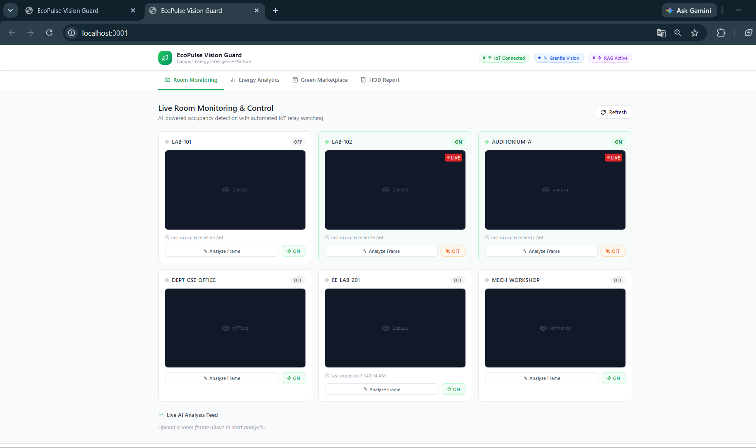
Project Visuals :

Slide 10
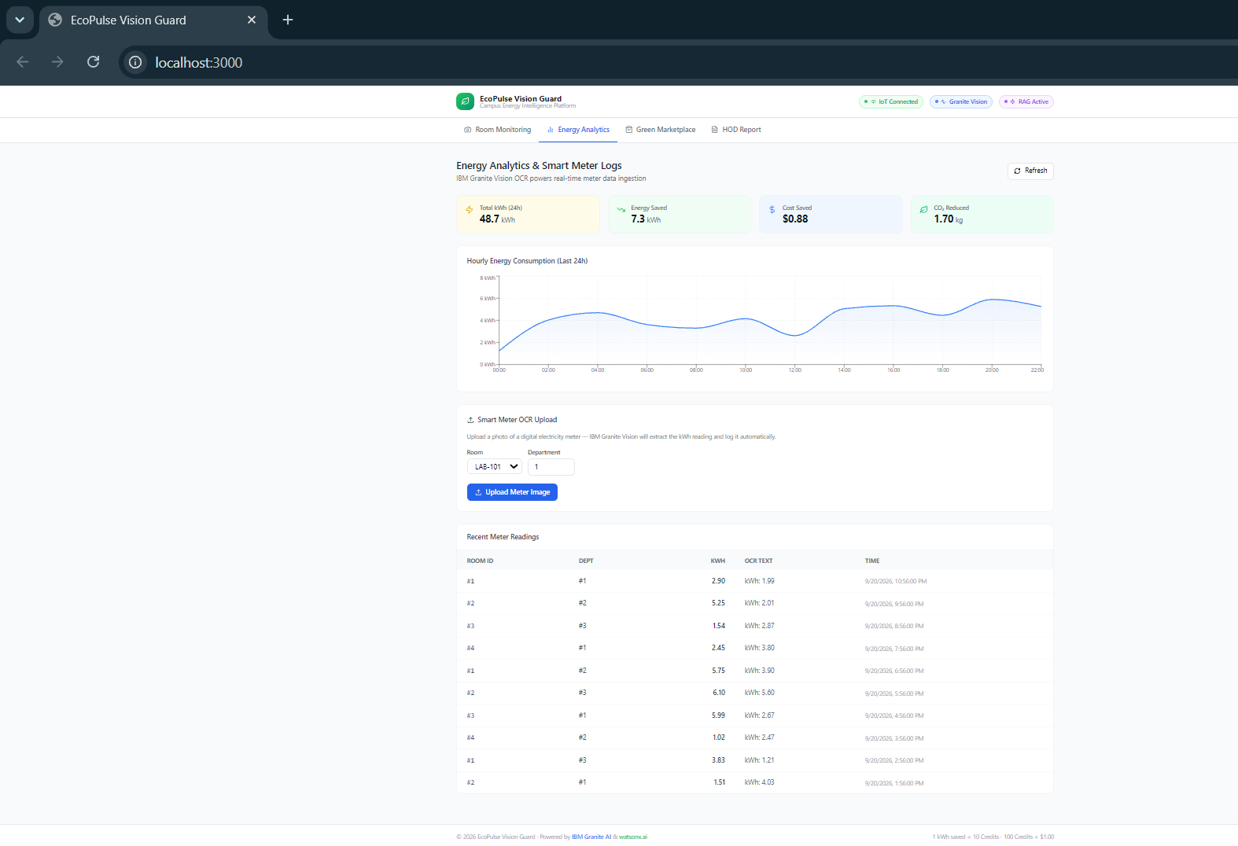
Project Visuals :

Slide 11
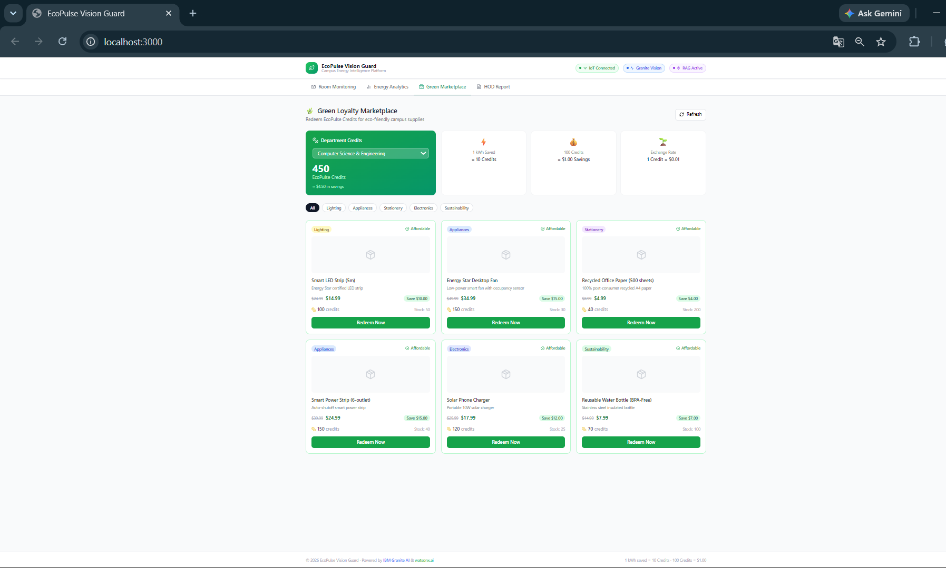
Project Visuals :

Slide 12
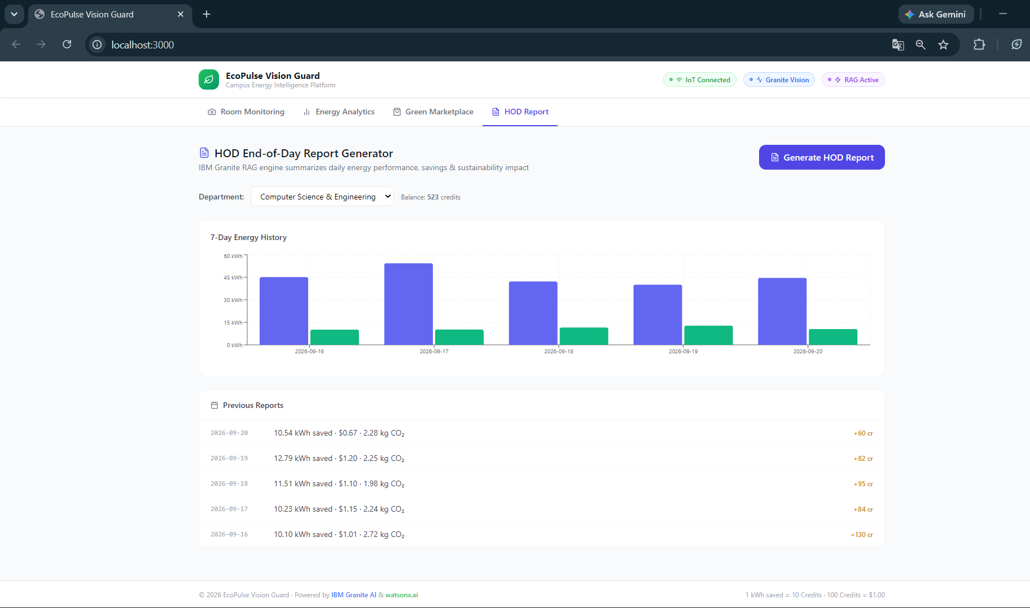
Project Visuals :

Slide 13
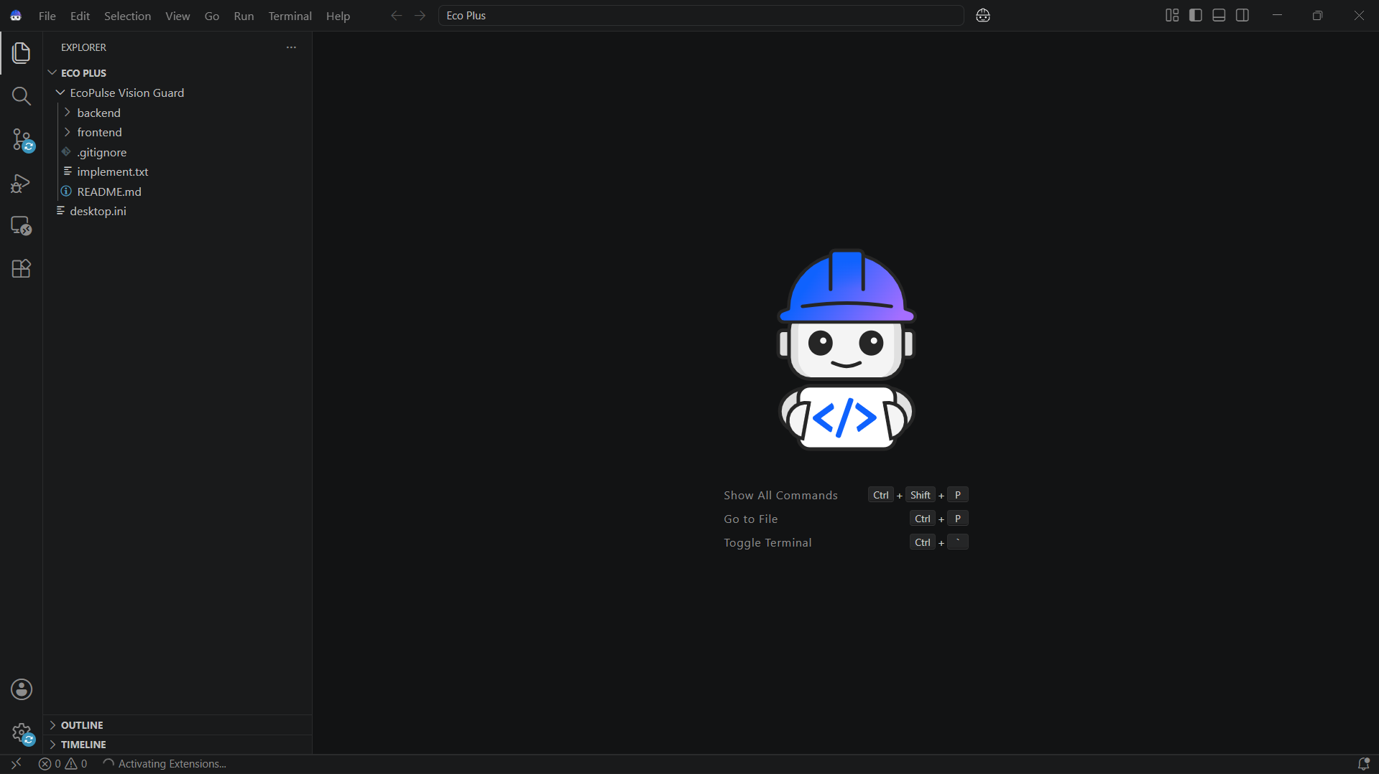
Model Used

Slide 14
Github Link:
https://github.com/prashantraiparshu83-ai/1M-B-Eco-Pulse-Energy-Intelligence-

